Slide 1









AI-detectie in de controlepraktijk
Robin Litjens

Slide 2

Overzicht
AI-detectie
AI-detectie in financiële verslaggeving
AI-detectie in de controleverklaring

Slide 3
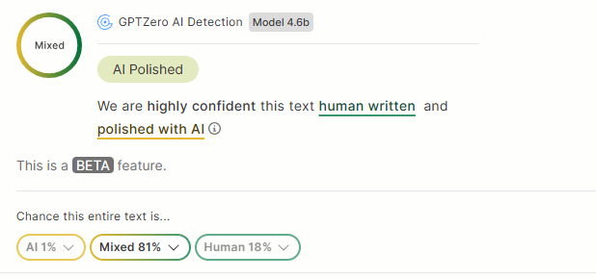
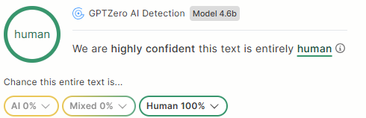
1984 - Orwell
1984 – ChatGPT
It could not have been ten seconds, and yet it seemed a long time that their hands were clasped together. He had time to learn every detail of her hand. He explored the long fingers, the shapely nails, the work-hardened palm with its row of callouses, the smooth flesh under the wrist. Merely from feeling it he would have known it by sight. In the same instant it occurred to him that he did not know what colour the girl's eyes were. They were probably brown, but people with dark hair sometimes had blue eyes. To turn his head and look at her would have been inconceivable folly. With hands locked together, invisible among the press of bodies, they stared steadily in front of them, and instead of the eyes of the girl, the eyes of the aged prisoner gazed mournfully at Winston out of nests of hair.
Their hands were only touching for a few seconds, but to him it felt much longer. During that brief moment, he noticed every detail of her hand — the length of her fingers, the shape of her nails, the roughness of her palm from physical work, and the softness near her wrist. The feeling was so distinct that he believed he could recognize her hand anywhere. At the same time, he realized he had never actually looked into her eyes or noticed their color. They were likely brown, although dark-haired people could sometimes have blue eyes. Turning to look at her directly would have been far too dangerous. Surrounded by the crowd, they kept their eyes forward, pretending not to notice each other, while the tired eyes of the old prisoner stared sadly toward Winston through tangled hair.

Slide 4
1984 - Orwell
1984 – ChatGPT
It could not have been ten seconds, and yet it seemed a long time that their hands were clasped together. He had time to learn every detail of her hand. He explored the long fingers, the shapely nails, the work-hardened palm with its row of callouses, the smooth flesh under the wrist. Merely from feeling it he would have known it by sight. In the same instant it occurred to him that he did not know what colour the girl's eyes were. They were probably brown, but people with dark hair sometimes had blue eyes. To turn his head and look at her would have been inconceivable folly. With hands locked together, invisible among the press of bodies, they stared steadily in front of them, and instead of the eyes of the girl, the eyes of the aged prisoner gazed mournfully at Winston out of nests of hair.
Their hands were only touching for a few seconds, but to him it felt much longer. During that brief moment, he noticed every detail of her hand — the length of her fingers, the shape of her nails, the roughness of her palm from physical work, and the softness near her wrist. The feeling was so distinct that he believed he could recognize her hand anywhere. At the same time, he realized he had never actually looked into her eyes or noticed their color. They were likely brown, although dark-haired people could sometimes have blue eyes. Turning to look at her directly would have been far too dangerous. Surrounded by the crowd, they kept their eyes forward, pretending not to notice each other, while the tired eyes of the old prisoner stared sadly toward Winston through tangled hair.

Slide 5
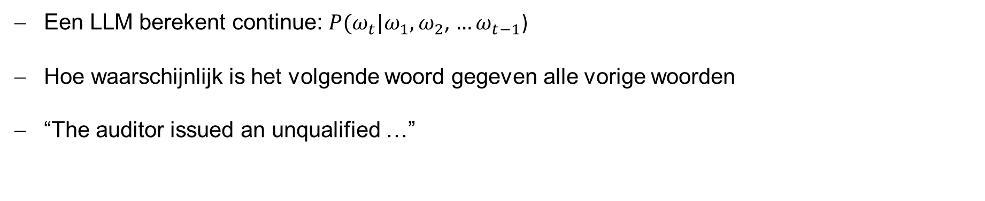
AI-detectie (LLM)
Een LLM berekent continue: $P(ω_{t}|ω_{1},ω_{2}$, $…ω_{t−1}$)
Hoe waarschijnlijk is het volgende woord gegeven alle vorige woorden
“The auditor issued an unqualified …”
Woord | Kans
opinion | 0.72
report | 0.12
statement | 0.05
elephant | 0.000001

Slide 6
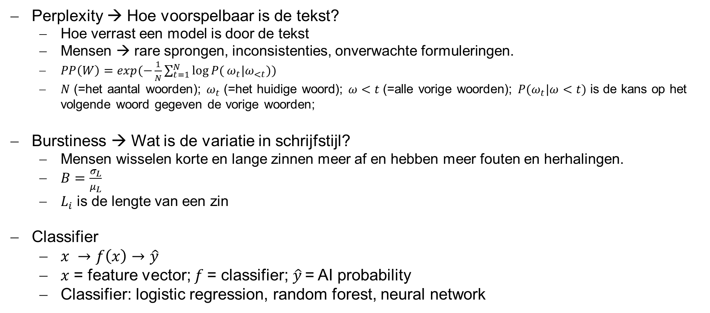
AI-detectie (GPT-zero)
Perplexity → Hoe voorspelbaar is de tekst?
  Hoe verrast een model is door de tekst
  Mensen → rare sprongen, inconsistenties, onverwachte formuleringen.
  $PP\left(W\right)=exp(−\frac{1}{N}\sum_{t=1}^{N}{log⁡P(}ω_{t}|ω_{<t}))$
  $N$ (=het aantal woorden); $ω_{t}$ (=het huidige woord); $ω<t$ (=alle vorige woorden); $P(ω_{t}|ω<t)$ is de kans op het volgende woord gegeven de vorige woorden;
Burstiness → Wat is de variatie in schrijfstijl?
  Mensen wisselen korte en lange zinnen meer af en hebben meer fouten en herhalingen.
  $B=\frac{σ_{L}}{μ_{L}}$
  $L_{i}$ is de lengte van een zin
Classifier
  $x →f\left(x\right)→\hat{y}$
  $x$ = feature vector; $f$= classifier;$\hat{y}$ = AI probability
  Classifier: logistic regression, random forest, neural network
Notes:
Hoe lager de perplexity, hoe voorspelbaarder de tekst voor het model. AI-tekst heeft vaak lagere perplexity omdat woorden statistisch “logischer” op elkaar volgen. Probabilistisch -gemiddelde negatieve log-likelihood

Slide 7
AI-detectie (ontwikkelingen)
AI-detectie is fundamenteel onzeker!
  Statistische waarschijnlijkheidsinschatting
  Kat en muis-spel
Vergelijking met bekende AI-patronen
  Vergelijkbaar aan spam-detectie in mailbox (typische AI-overgang, overmatig neutrale toon, generieke formuleringen, te perfecte structuur)
Focus nu op provenance
  In plaats van detectie – bewijs waar content vandaan komt, welk model het maakte (via standaarden als C2PA en content credentials)

Slide 8
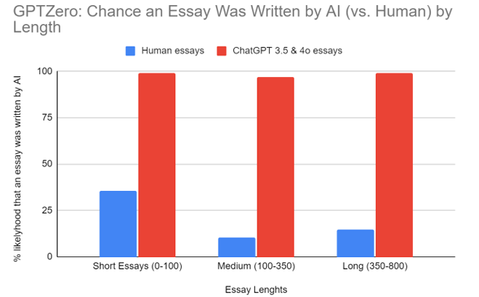
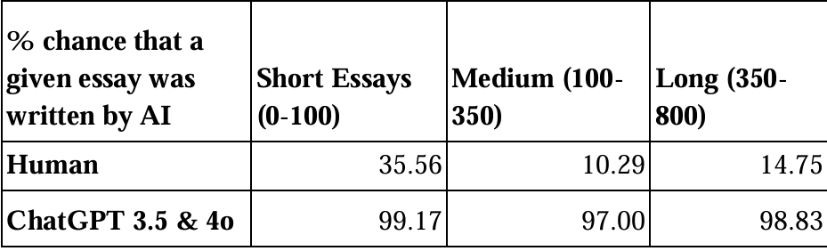
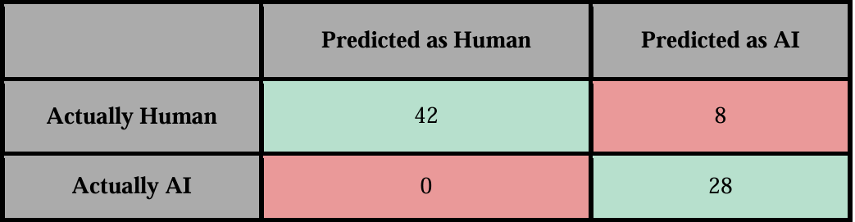
AI-detectie (GPTZERO.COM peformance)
Blauw: False Positives
Dik & Erdem (2025)

Slide 9
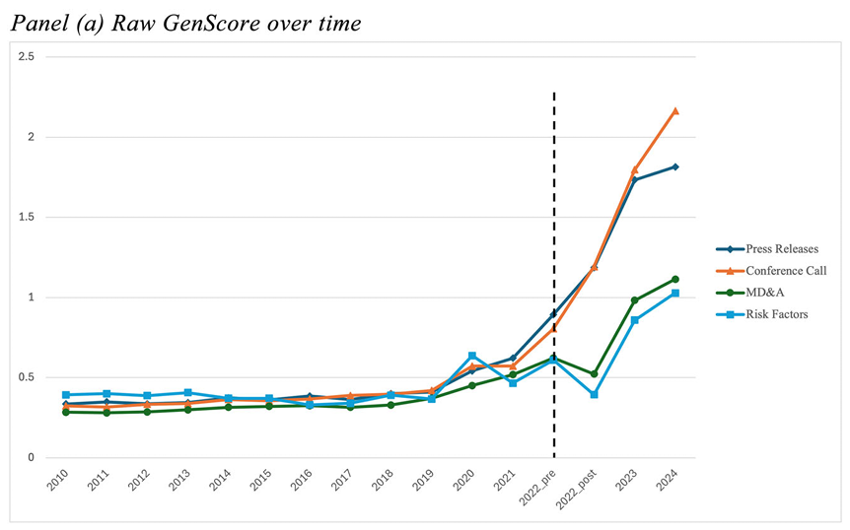
AI-detectie in financiële verslaggeving
Blankespoor, Dehaan & Li (2026)

Slide 10
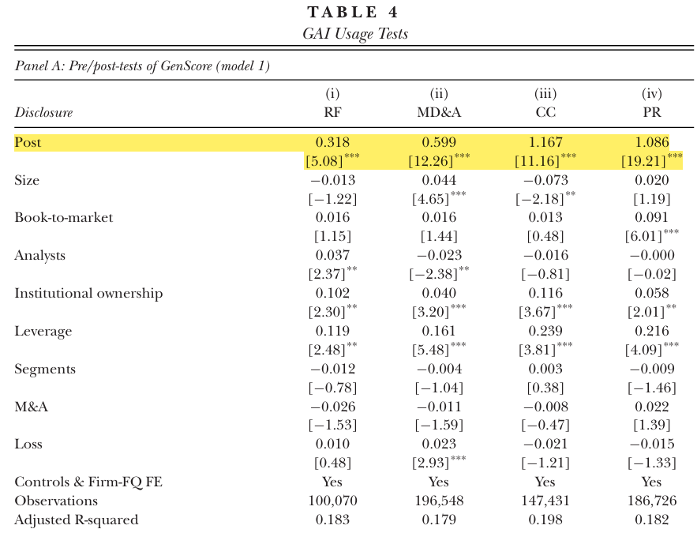
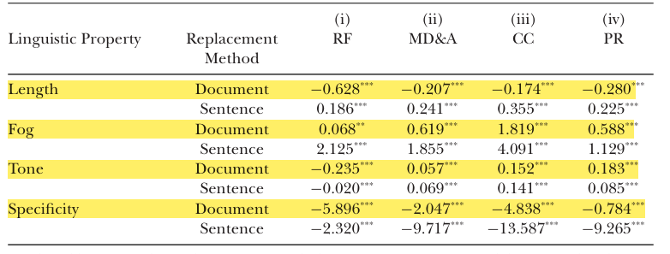
AI-detectie in financiële verslaggeving
Blankespoor, Dehaan & Li (2026)

Slide 11


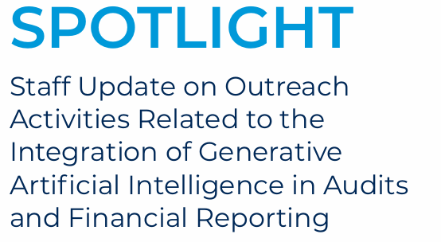

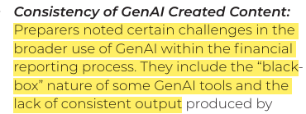
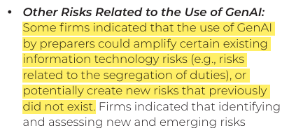
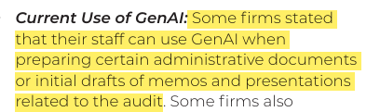
AI-detectie in controleverklaringen

Slide 12
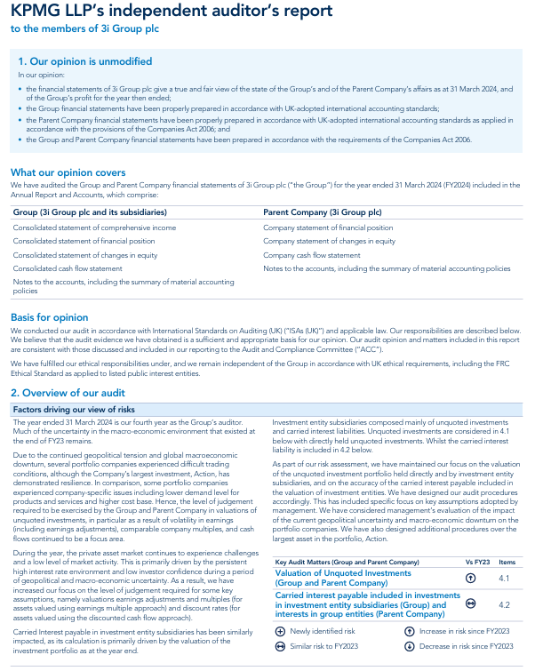
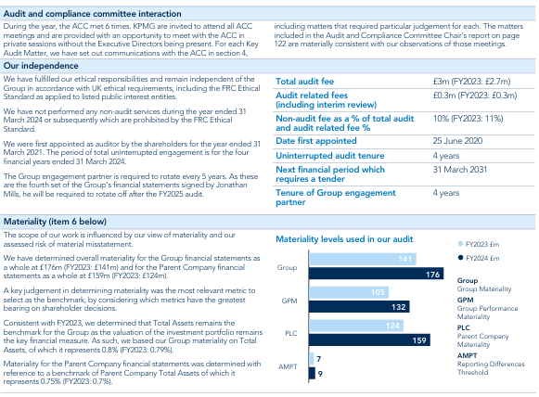
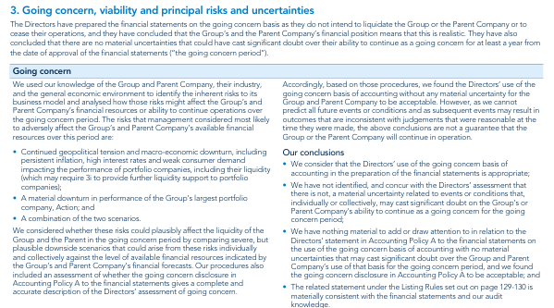
AI-detectie in controleverklaringen

Slide 13
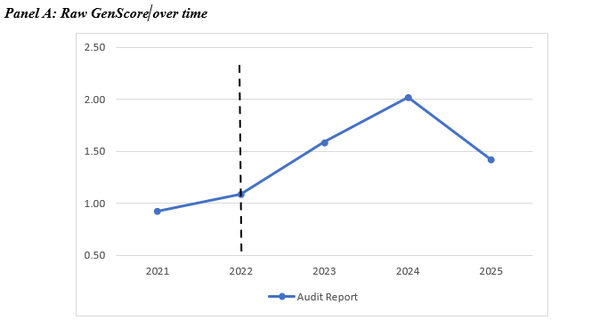
AI-detectie in controleverklaringen
Boilerplate → Boilerplate (no change)
Client-specific → changes
Van Buuren and Litjens (2026)

Slide 14
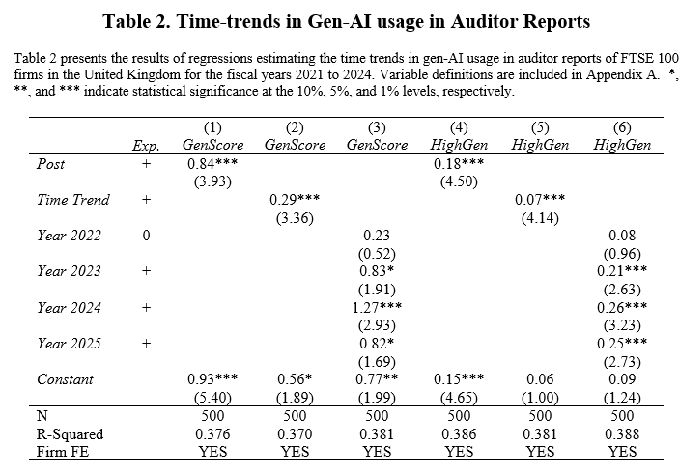
AI-detectie in controleverklaringen
Van Buuren and Litjens (2026)

Slide 15
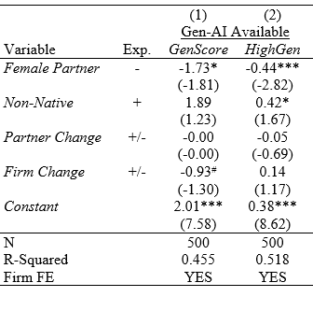
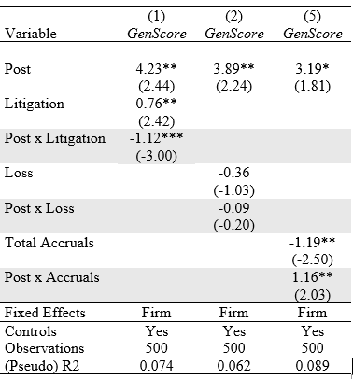
AI-detectie in controleverklaringen
Auditor characteristics
Auditee risk
Van Buuren and Litjens (2026)

Slide 16
Afsluitend
Ontbrekende jurisprudentie, uitspraken toezichthouders
Hoe meer een controleverklaring door een LLM wordt gegenereerd, hoe moeilijker het wordt om te verdedigen dat deze volledig het resultaat is van professioneel oordeel.
Efficiëntiewinst door AI kan omslaan in verhoogd toezicht-, aansprakelijkheids- en reputatierisico.
Wanneer controleverklaringen steeds meer probabilistisch gegenereerde tekst worden, rijst de vraag hoe dit zich verhoudt tot de leer van het gewekte vertrouwen.

Slide 17
Literature
Dik, S., & Erdem, O. (2025). Assessing GPT-Zero’s Accuracy in Identifying AI vs. Human-Written Essays. Proceedings of International Mathematical Sciences, 7(2), 54-58.
Blankespoor, E., Dehaan, E., & Li, Q. (2026). Generative AI in financial reporting. Journal of Accounting Research.
Song, X., Hou, W., Ouyang, Z., & Hao, F. (2026). AI washing: Strategic disclosure and backlash. Finance Research Letters, 109684.
Van Buuren and Litjens, R. (2026) Generative AI in Auditor Reporting: Evidence from UK Audit Reports, Working Paper
Walters, W. H. (2023). The effectiveness of software designed to detect AI-generated writing: A comparison of 16 AI text detectors. Open Information Science, 7(1), 20220158.

